Slide 1
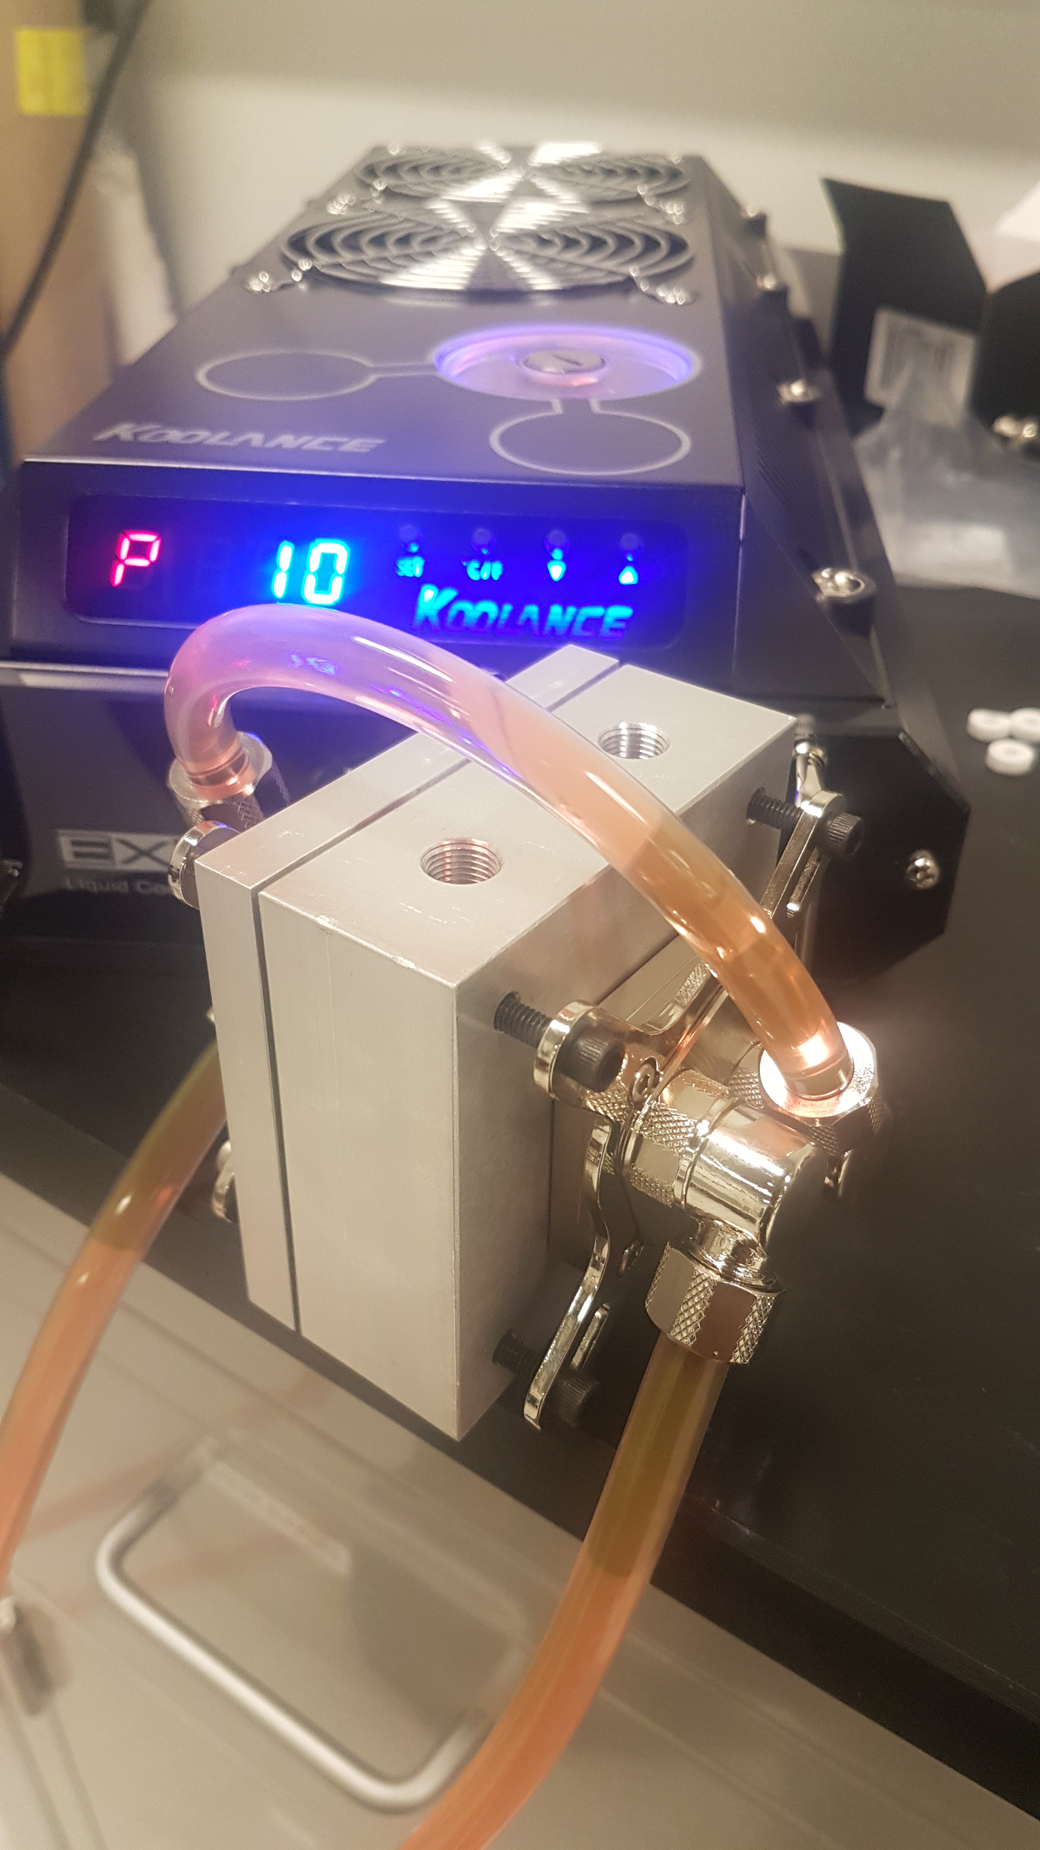
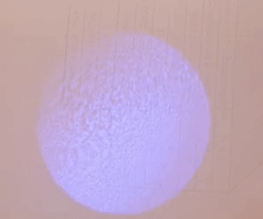

A compact injection-locked UV laser system for quantum information processing
Nikolay Videnov
Quantum Information with Trapped Ions (QITI) Group

Slide 2
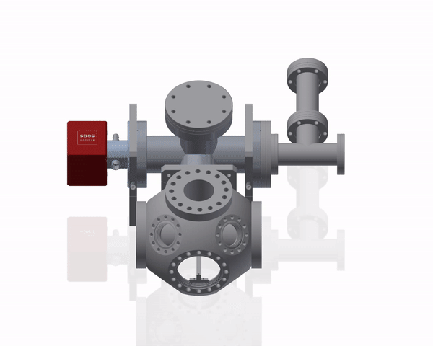
Quantum Information With Trapped Ions
New lab
Quantum simulator using trapped ions
Tackle computationally hard problems using an engineered Hamiltonian

Slide 3
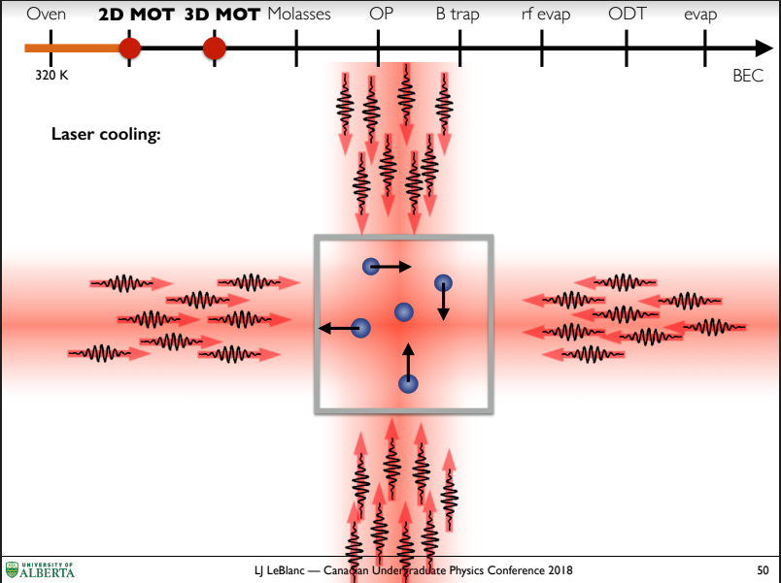
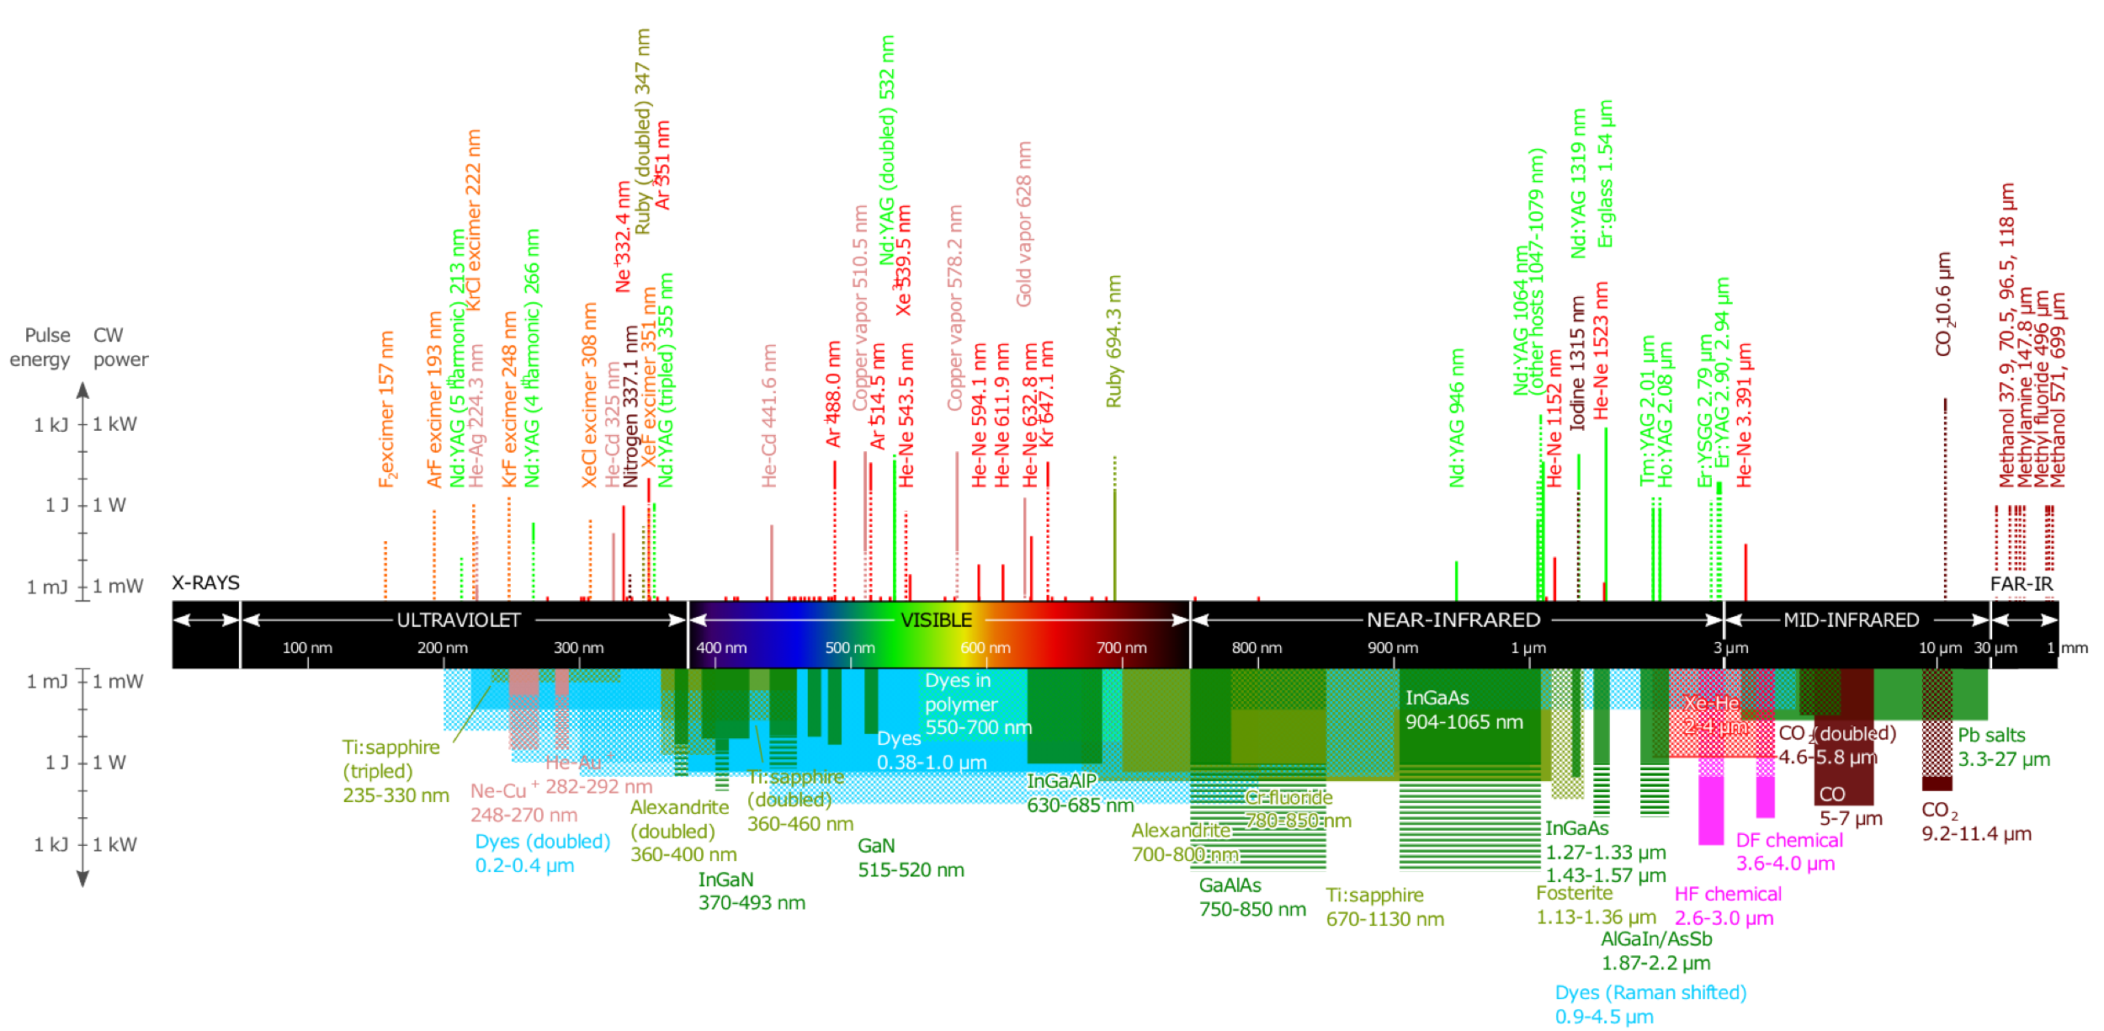
UV lasers
Uses
Laser Cooling
Optical pumping
State Detection
Getting UV light
Frequency doubling Ti:Sapph
External Cavity Diode Laser
Injection locking

Slide 4

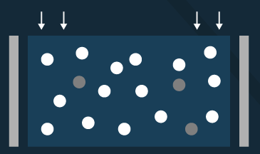
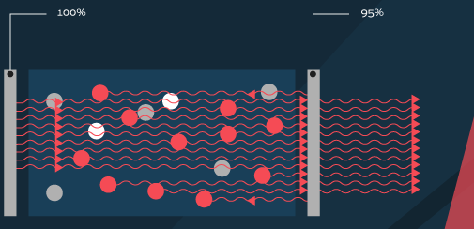
Cavity Laser
Cavity laser
Gain medium electronically pumped
Saturation occurs forcing lasing
Injection locking
Inject seed signal
Above threshold power is diverted into injected singal

Slide 5
Injection Locking
Cavity laser
Gain medium electronically pumped
Saturation occurs forcing lasing
Injection locking
Inject seed signal
Above threshold power is diverted into injected singal

Slide 6
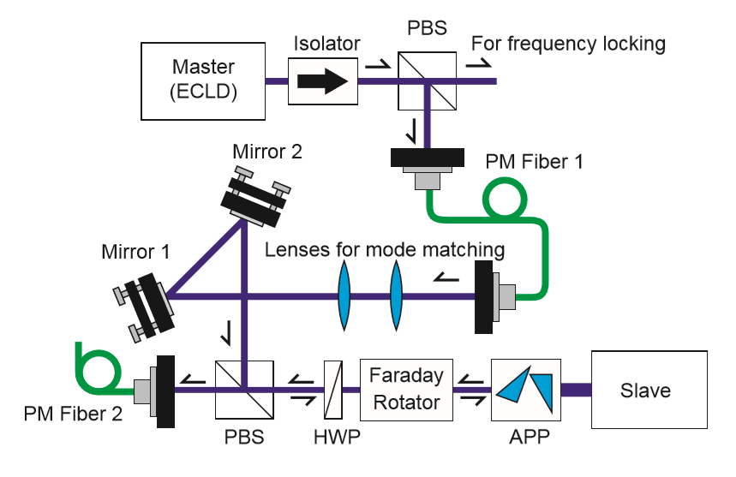
Physically realizing Injection Locking
Need mW-µW from a seed laser
Faraday isolator
Slave laser diode
T. Hosoya et al., Review of Scientific Instruments 86, 2015

Slide 7
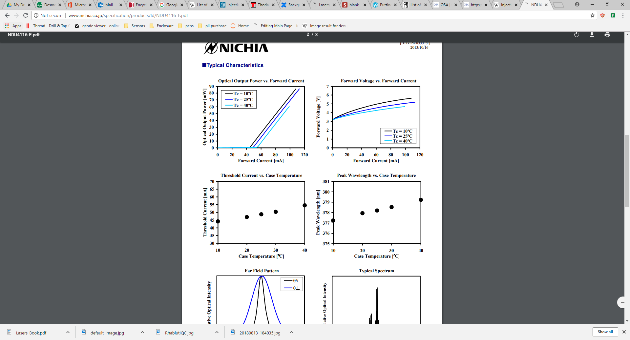
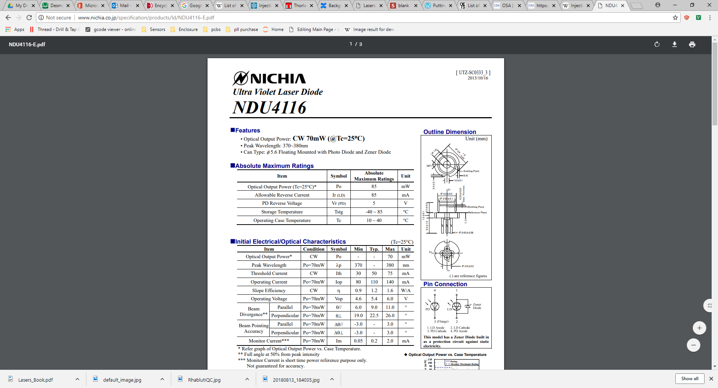
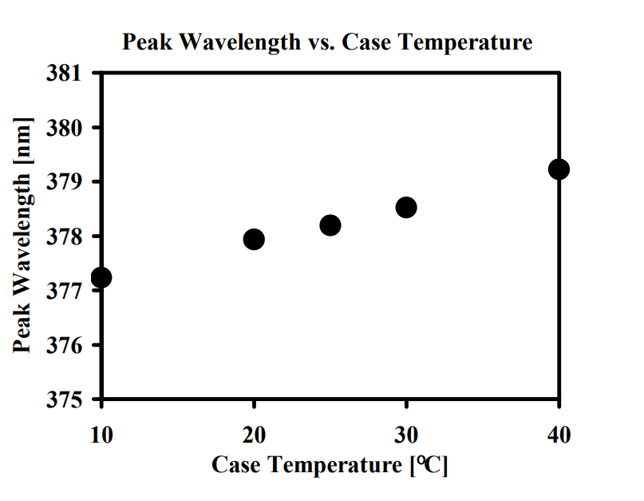
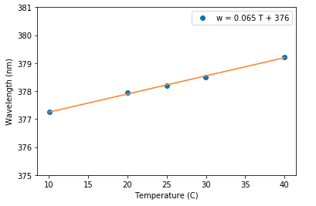
Diode Selection
Locking only happens around the free running oscillation frequency of the diode.
Need a laser diode around 369nm
The closest commercially available diode can be frequency selected to ~371nm*
Cool to 369nm?
*Nichia NDU4116 (370-380nm)

Slide 8
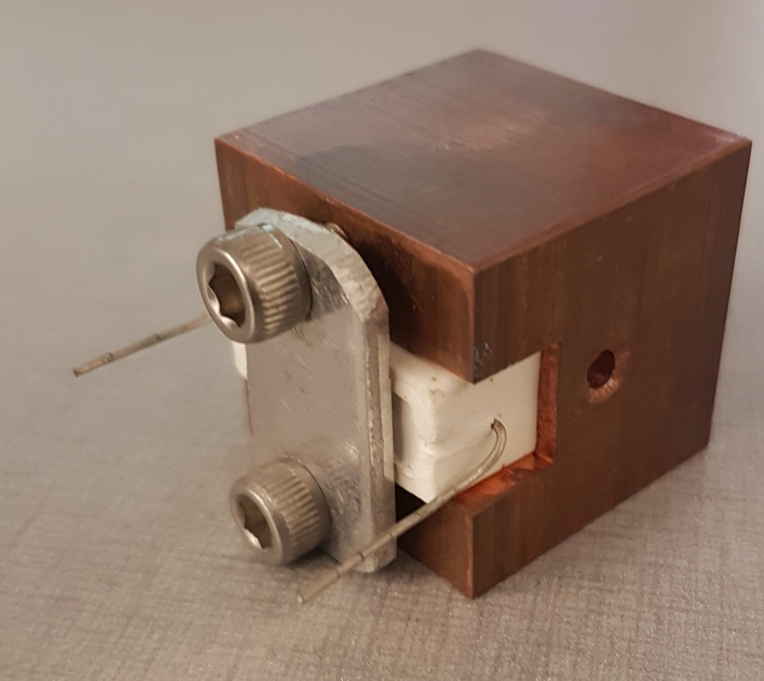
Test Fixture
20°C below lab temperature
Achievable with Thermoelectric Coolers (TEC)
A few heat load calculations later we pick a pair of TECs
Make a test block
Add a dummy load
Test diode holder
Dummy load

Slide 9
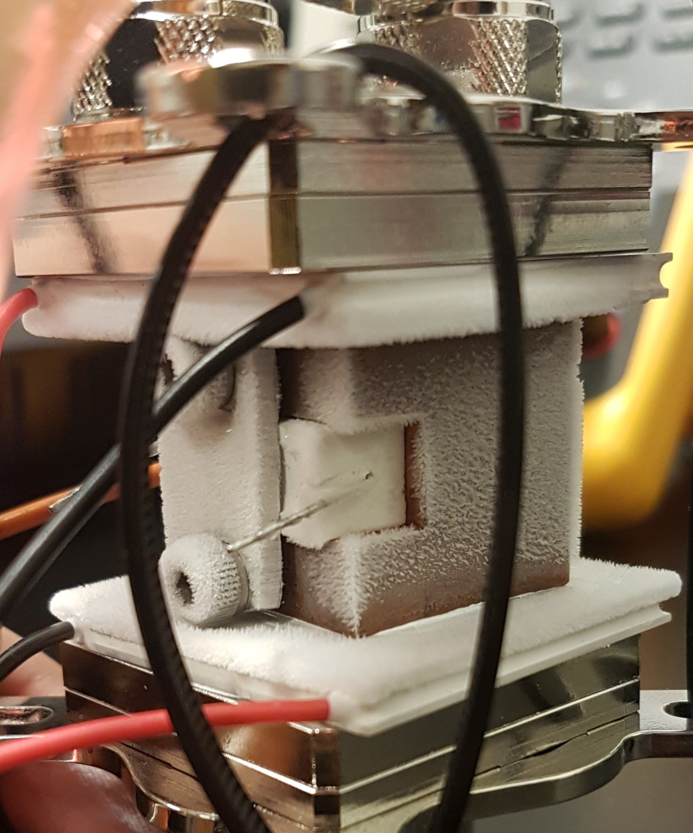
Laser Enclosure
Water Cooling
block
Cooling below the dew point causes
Condensation
frost
Pressurize with dry nitrogen
Feedthroughs
Optical
Pressurized air
electrical
TEC
Frost
Test diode holder
Dummy load
TEC
Water Cooling
block

Slide 10
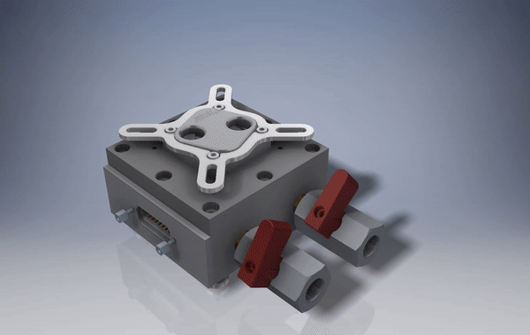

Slide 11
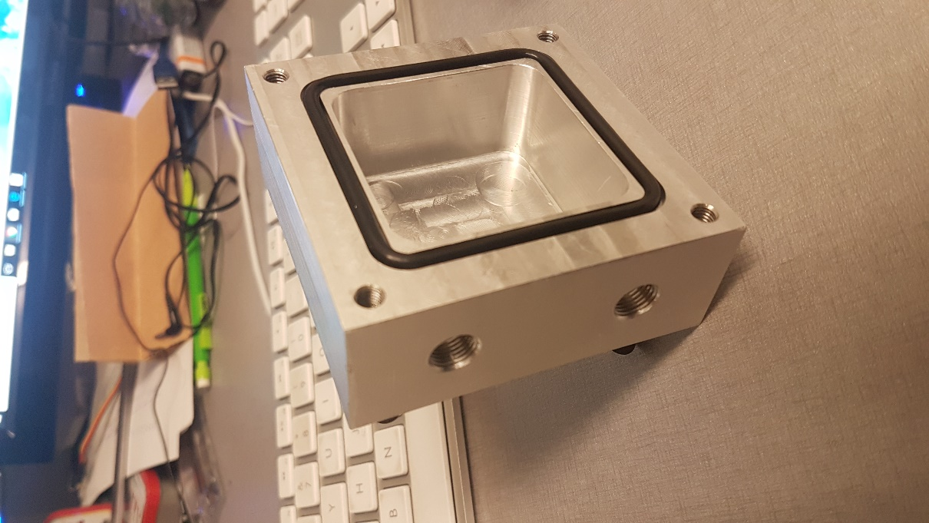
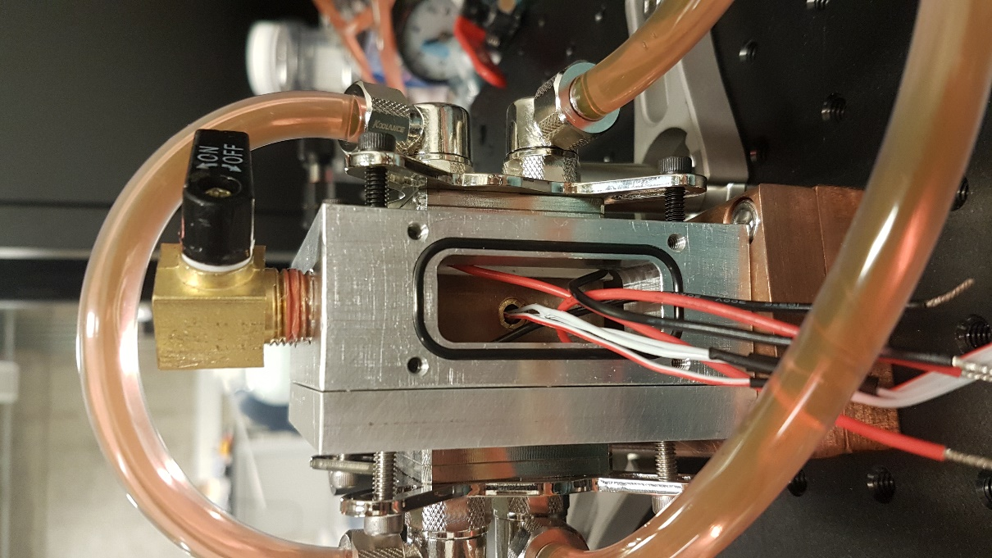
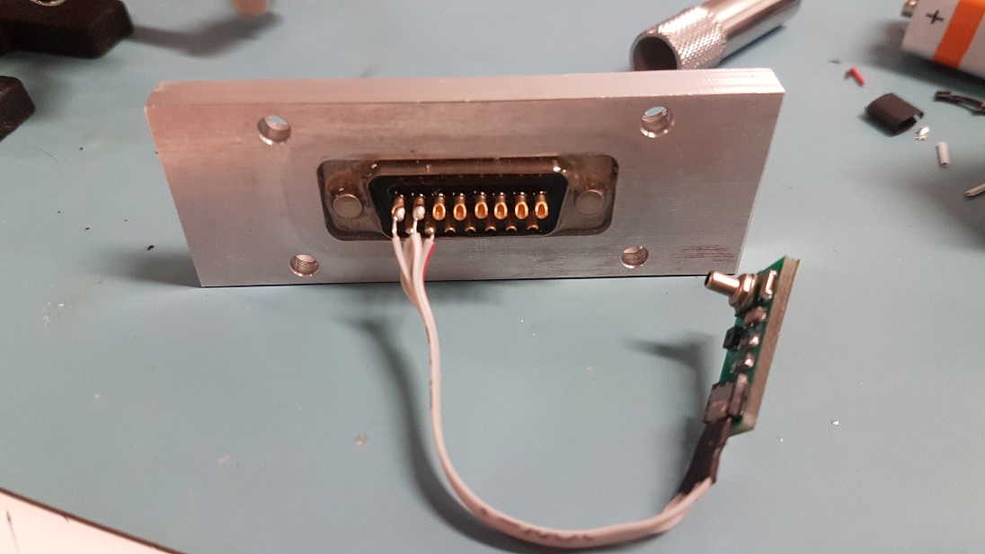
Laser Enclosure
Machined an enclosure
Time to test!
¼” NPT ball valve
Water cooling
bock
Diode Holder
O-ring
D-sub connector
Pressure Sensor

Slide 12
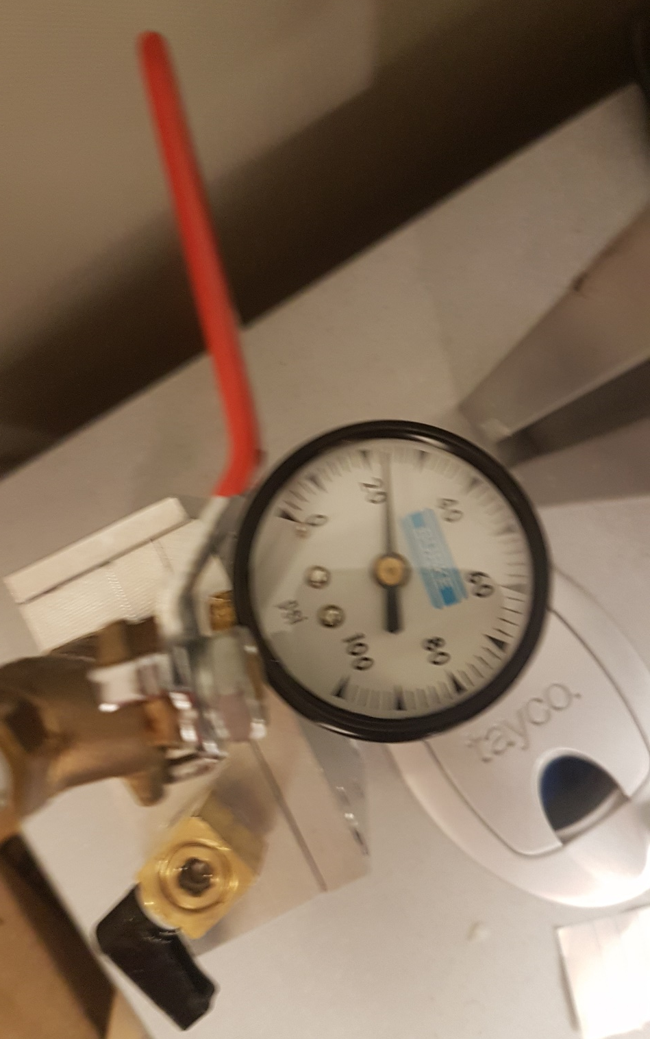
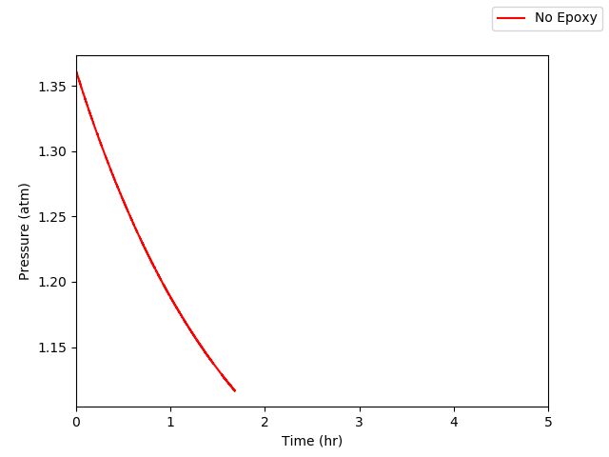
Climate Measurement
There’s a leak!
Make a blank and seal the D-sub connector

Slide 13
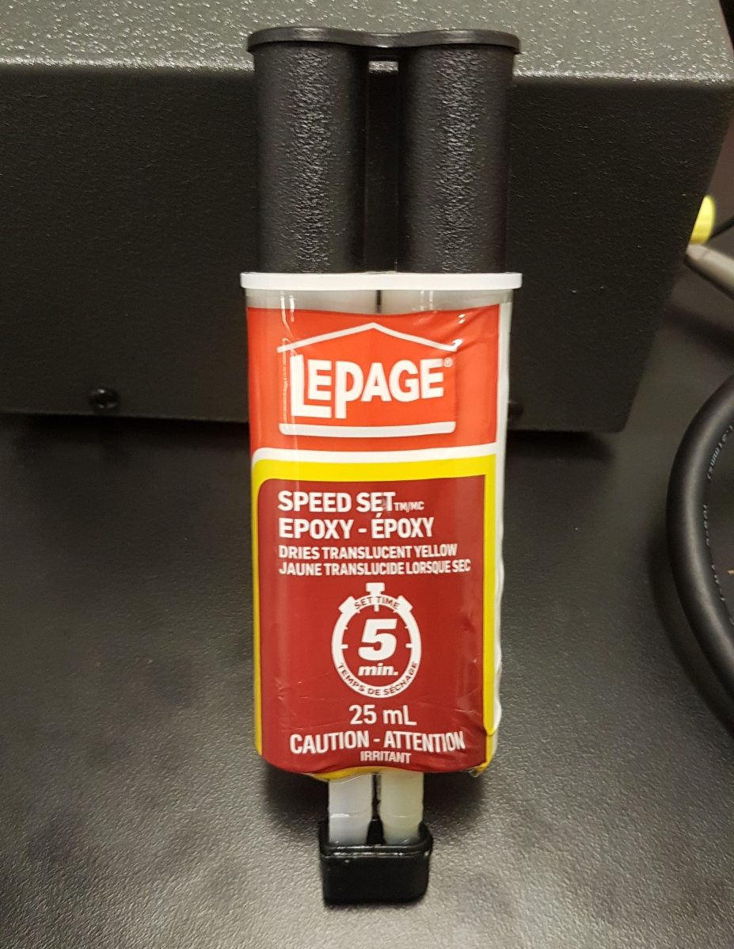
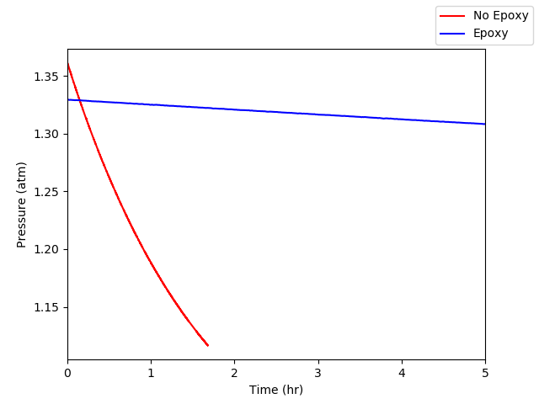
A fix all solution
5 minute epoxy
A measurable improvement!

Slide 14
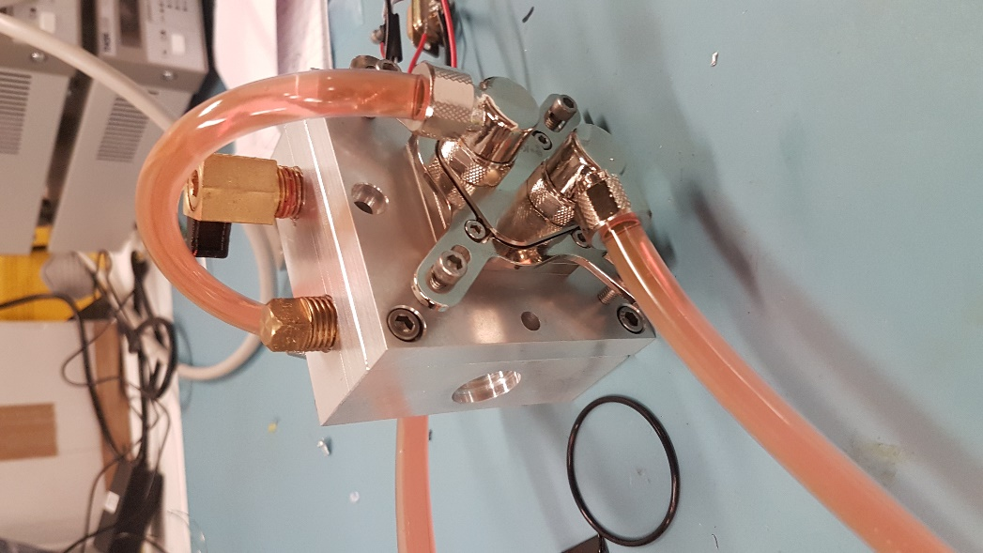
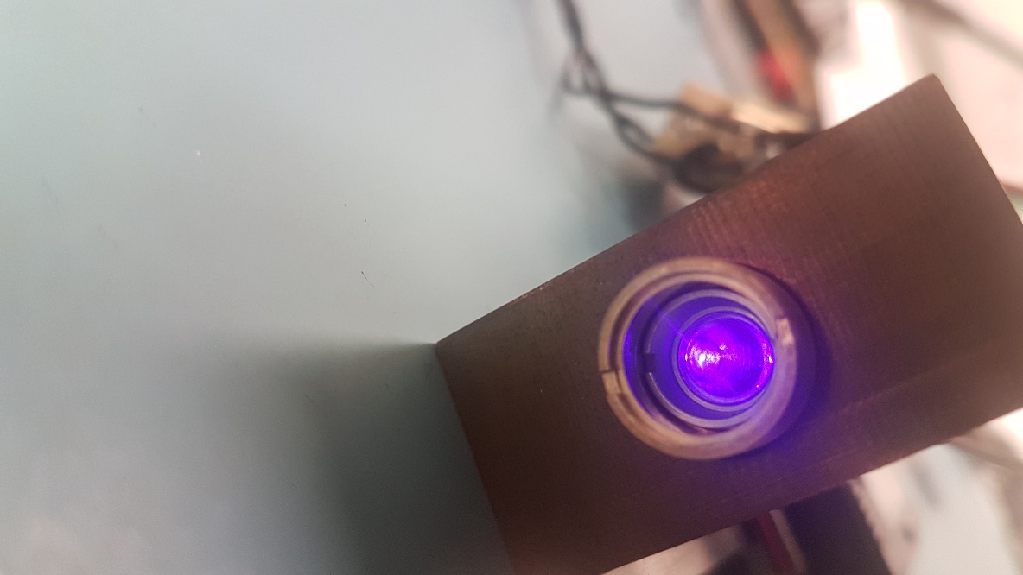
Putting it all together
Machined diode holder and enclosure
Compact collimation
Water-cooling
Constant current controller

Slide 15
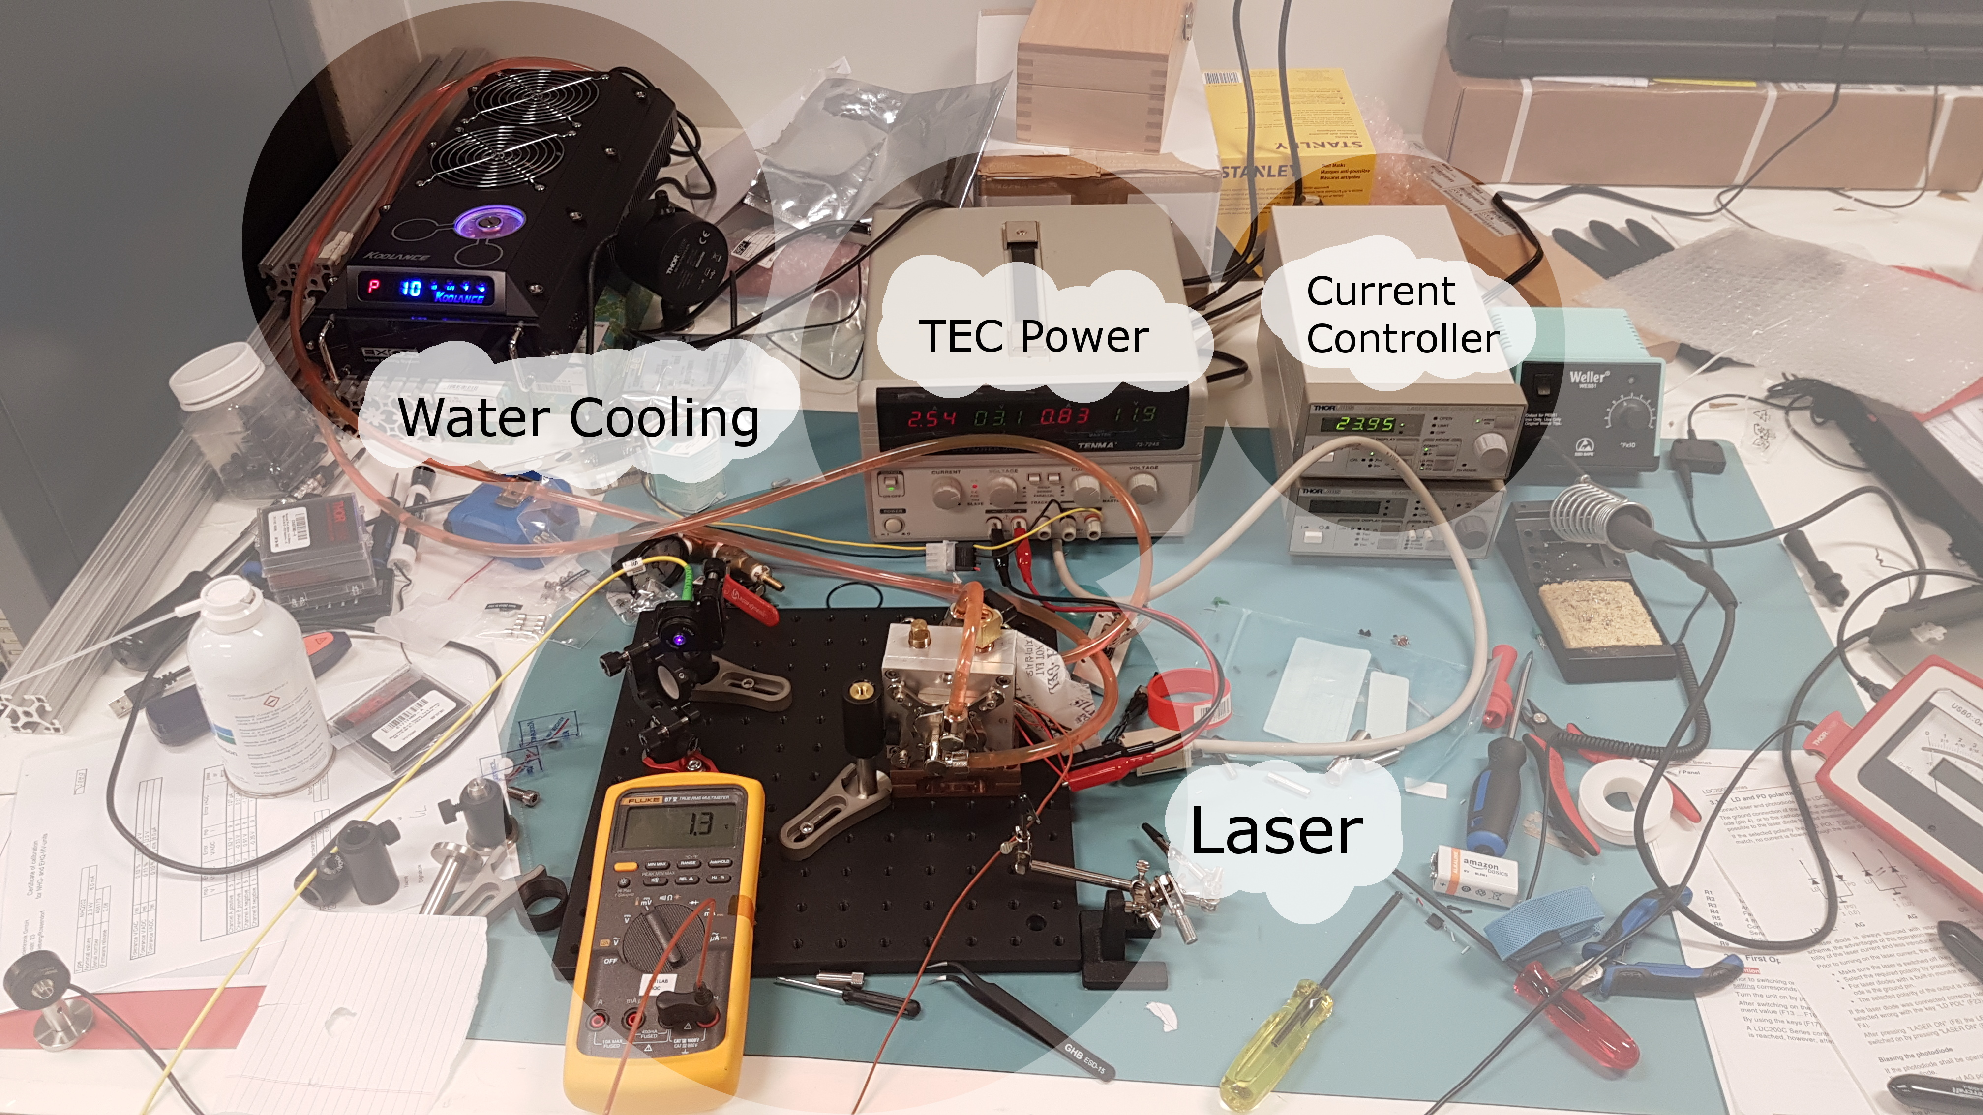
Experimental setup

Slide 16
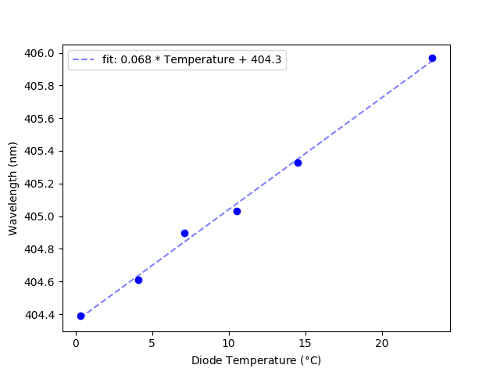
Results
Cooled diode without condensation

Slide 17
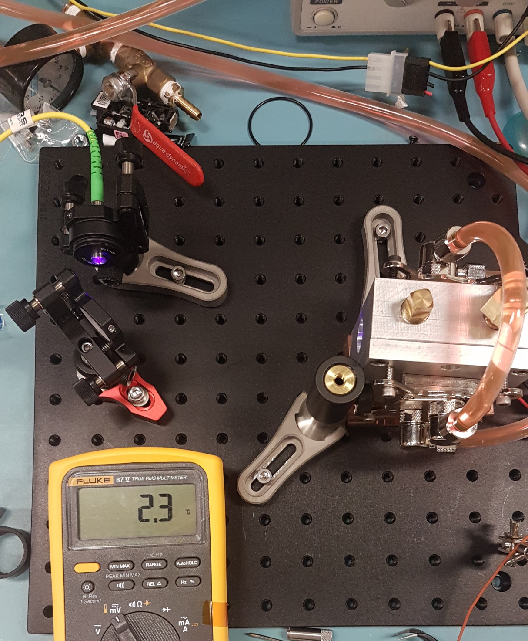
Conclusion/Outlook
Injection locking is an excellent way to amplify laser power
The challenges of injection locking can be tackled effectively with this design

Slide 18
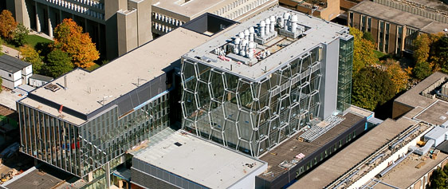







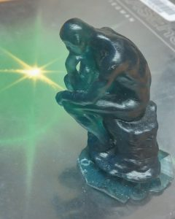
Quantum Information with Trapped Ions (QITI)
research.iqc.uwaterloo.ca/qiti/
Rajibul
Islam
Fereshteh Rajabi
Roland Hablützel
Chung-You (Gilbert) Shih
Nikhil Kotibhaskar
Sainath Motlakunta
Yi Hong
Teoh
P I
P O S T D O C S
G R A D U A T E S T U D E N T S
U N D E R G R A D S

Slide 19
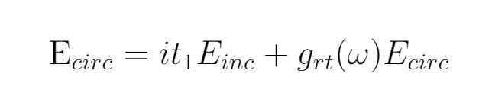
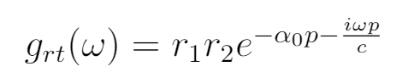
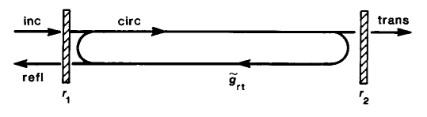
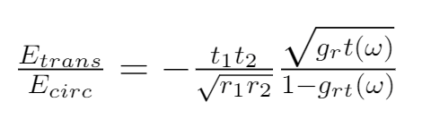
Injection Locking

Slide 20
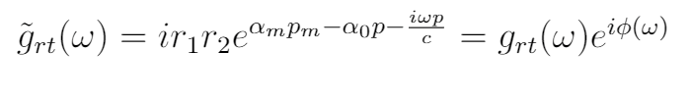
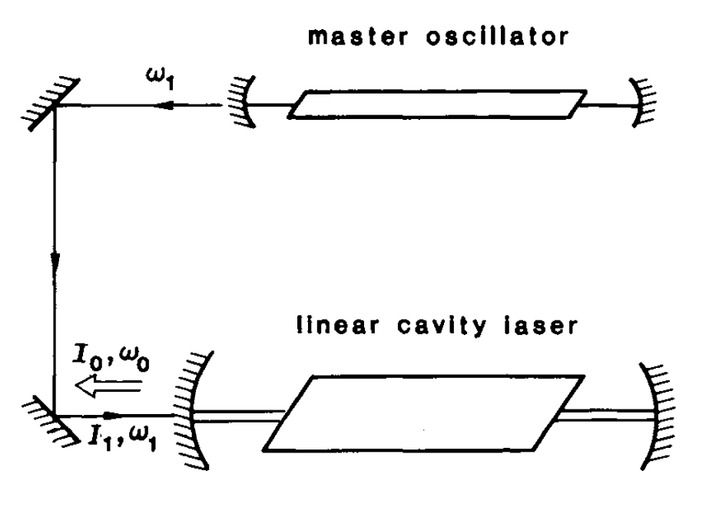
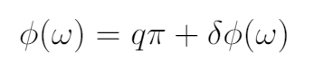
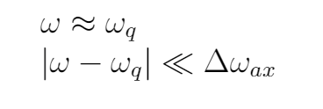
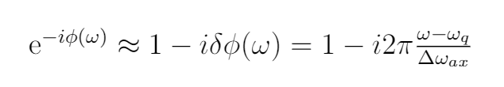

Slide 21
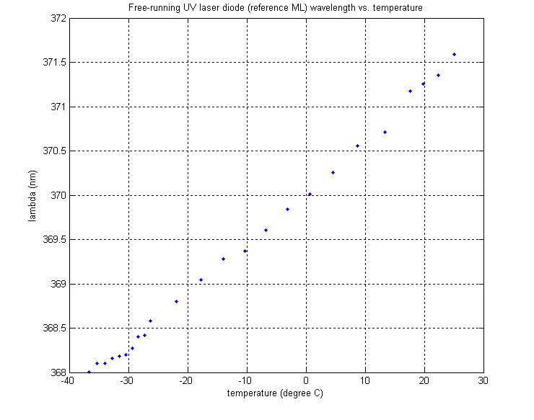

Slide 22
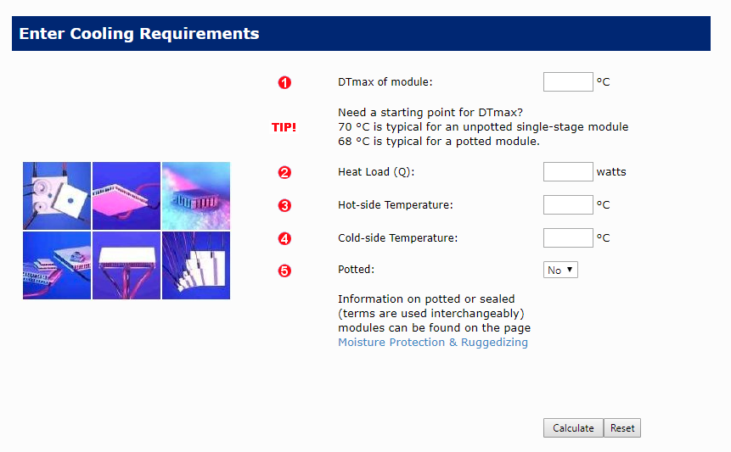
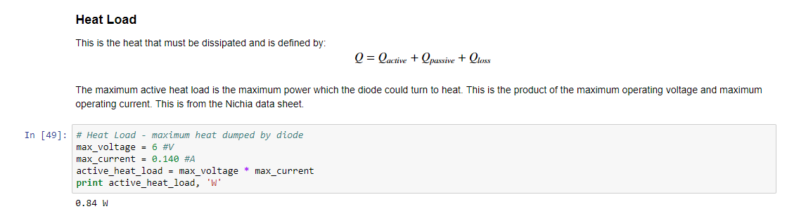
Head Load

Slide 23
UV lasers
Uses
Micro lithography
Laser ablation
Trapped ions
Getting UV light
Frequency doubling Ti:Sapph
External Cavity Diode Laser
Injection locking

